Slide 1

EduEx: Empower Your Learning & Skill Sharing
By EduEx

Slide 2

Introduction
EduEx is an innovative educational platform designed to transform learning and skill sharing.
Our mission is to empower students to connect, learn, and share their knowledge with each other.

Slide 3
What is EduEx?
EduEx is a concept or platform where individuals exchange skills, knowledge, or services without monetary transactions. It can be implemented in communities, businesses, or online platforms.
Skill Matching – Connects individuals with complementary skills for mutual learning or service exchange .
User Profiles – Allows users to showcase their skills, experience, and interests .
Skill Categories – Covers a broad range of skills, such as coding, language learning, graphic design, cooking, and more .
Time-Based Exchange – Some platforms use a time-credit system where one hour of service equals one hour of another skill .
Community & Networking – Encourages collaboration and relationship-building among users .
Messaging & Communication – Users can directly communicate to negotiate skill trades .
Reviews & Ratings – Builds trust by allowing users to rate and review exchanges .
Event & Group Swaps – Some platforms facilitate group learning sessions or events for multiple participants .
Location-Based or Virtual – Skill swaps can be arranged locally or conducted online .
Privacy & Security Features – Ensures safe interactions between participants .

Slide 4

Why EduEx?
1
Personalized Learning
2
Collaborative Learning
Tailored learning experiences to match individual needs and goals.
Connect with peers, share knowledge, and learn from each other.
3
Real-World Skills
Develop practical skills that are relevant to today's job market.

Slide 5


Key Features

Slide 6
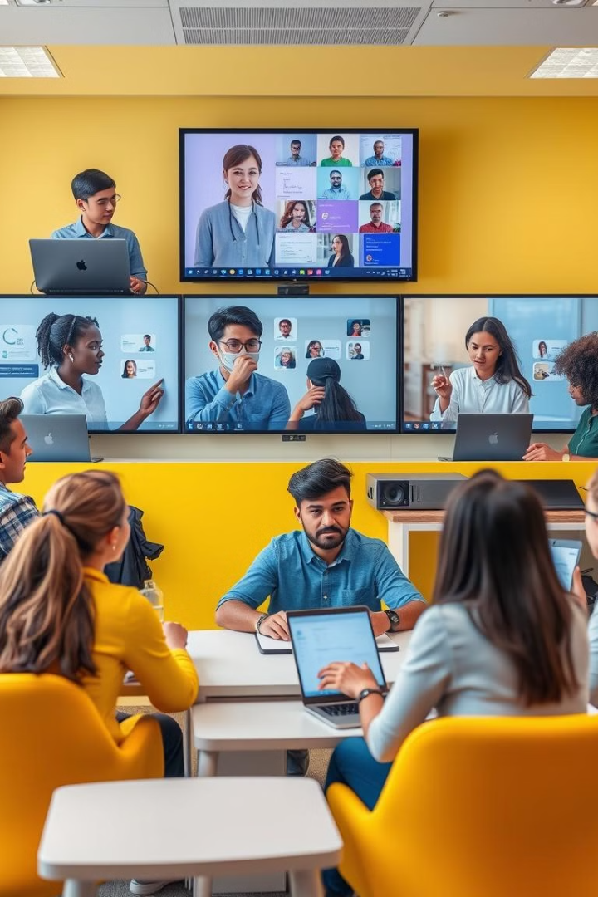
Engaging Learning Experiences
1
Interactive Content
Videos, quizzes, and activities to keep learners engaged and motivated.
2
Expert Instructors
Learn from industry professionals and experienced educators.
3
Personalized Feedback
Receive personalized feedback on your progress and areas for improvement.

Slide 7

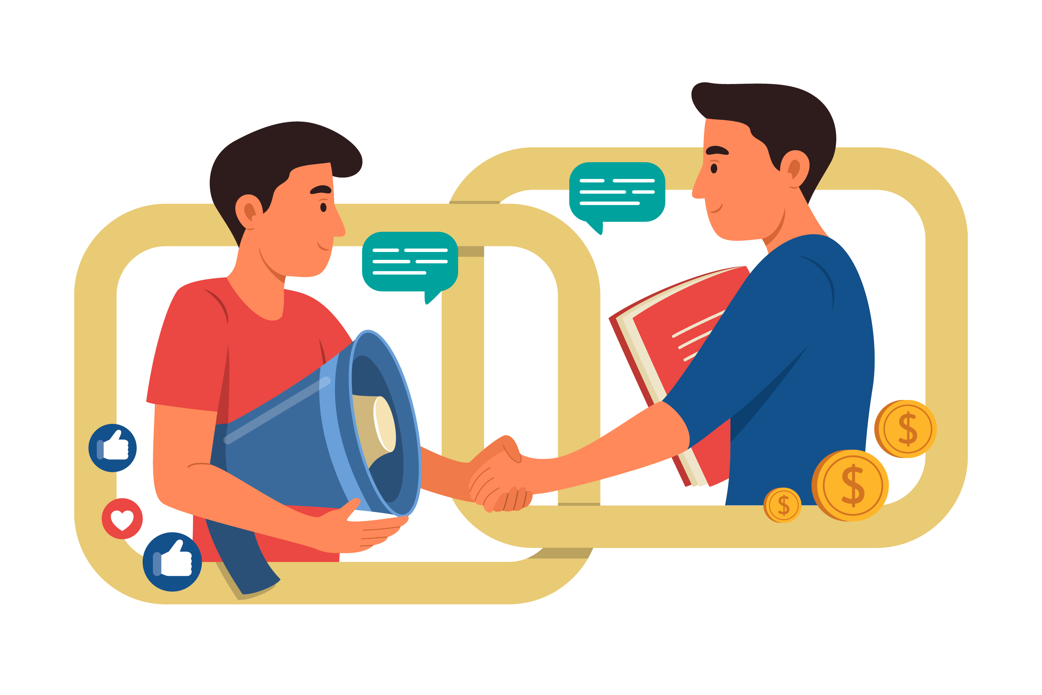


Skill Sharing Marketplace
Showcase Your Skills
Create a profile, list your skills, and offer your services.
Find Experts
Connect with talented individuals and collaborate on projects.
Earn Recognition
Build your reputation and earn rewards for your contributions.

Slide 8




Collaborative Tools
Group Projects
1
Work together on real-world projects and learn from each other.
Discussion Forums
2
Share insights, ask questions, and engage in discussions.
Live Chat
3
Connect with peers and mentors in real-time.
Virtual Whiteboard
4
Collaborate on ideas and brainstorm together.

Slide 9
THANK YOU !!!

